Slide 1
WELCOME TO SKY MOBILE & ELECTRONICS FRANCHISEE

Slide 2
Agenda
SKY MOBILE & ELECTRONICS INFO.
SKY MOBILES & ELECTRONICS AND SALES INFO.
SKY MOBILES & ELECTRONICS FRANCISEE DETAILS.

Slide 3
SKY MOBILES AND ELECTRONICS INFO

Slide 4
What does our logo mean?
We have honed our expertise in the mobile chain category for over two decades, since 2001.
We have been relentlessly honing our expertise in the mobile chain category for more than two decades now, and as a result, we have emerged as the undisputed leaders and pioneers in providing exceptional mobile services.

Slide 5
OUR VISION
Sky Mobile & Electronics is driven by a passionate mission to create a world-class manufacturing facility.
Our goal for 2023-2024 is to construct our own factory.

Slide 6
OUR mission
Sky Mobile and Electronics is committed to creating affordable and innovative products to promote world peace.

Slide 7
OUR CURRENT BRANCHES
We are fortunate to have a thriving presence across Tamil Nadu and Pondicherry, with a total of 28 branches.

Slide 8
OUR EMPLOYEE STRENGTH
Our organization comprises a total of over 250 + employees.
We have 30+ strong and experienced team members in our head office to support and drive our business.

Slide 9
Organization hierarchy
Executive director
MOBILE ASM ZONE-1
MOBILE ASM ZONE-2
ACCESSORIES AND GADGETS
ASM
SIM AND RECHARGE ASM
SERVICE ASM
PURCHASE & ADMIN
ACCOUNTS AND LOGISTICS
14 BRANCH
MANAGERS
14 BRANCH
MANAGERS
28 BRANCH MANAGERS
28 BRANCH MANAGERS
28 BRANCH MANAGERS
28 BRANCH MANAGERS
28 BRANCH MANAGERS
PROMOTER
&
STAFF
PROMOTER
&
STAFF
PROMOTER
&
STAFF
PROMOTER
&
STAFF
PROMOTER
&
STAFF
PROMOTER
&
STAFF
PROMOTER
&
STAFF

Slide 10
SKY MOBILES AND ELECTRONICS SALES INFO

Slide 11
Our current ANNUAL turnover
Our dedication and hard work have resulted in a yearly turnover of 100 crore across all branches. Let's continue to strive for excellence and aim for even greater success, with a sales growth target of 200 crores in the upcoming financial year.

Slide 12
2023 SALES REPORT

Slide 13
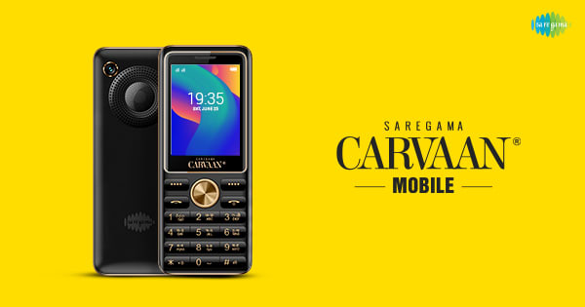
We are privileged to work with some of the most amazing brands for direct billing

Slide 14
By dealing with brands that offer gadgets and direct billing, we are empowering our customers to stay connected to the world in a more convenient way

Slide 15
Experience the magic of entertainment with our exquisite range of brands specializing in television and audio products.

Slide 16
NO.1 SERVICE
Our logo encapsulates our commitment to providing the best service, and it serves as a constant reminder of our goal to inspire and exceed expectations.

Slide 17
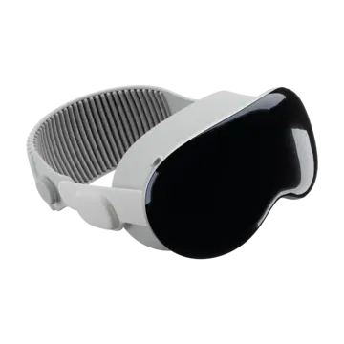
INNOVATIVE GADGETS
In the upcoming financial year, we will be investing in innovative gadgets that will pave the way for a brighter and more advanced future.

Slide 18
SKY MOBILES & ELECTRONICS FRANCHISE DETAILS

Slide 19
What is a franchise?
Franchising is a business model in which an individual purchases the right to use the trademark, branding, and business system of an established company.

Slide 20
Franchisee statistics.
Greatest Marketing idea ever.
Contributes around USD 4.8 TRILLION to the world economy.
Is about USD 150 BILLION in the Indian market.
Franchising has witnessed a 25% growth annually.
2.5 lac Business format franchise across India.
60% of Entrepreneurs in India are 1St generation entrepreneurs.

Slide 21
Sky franchisees provide benefits for business growth and success.
Please note that all communicated discounts will be given on the respective bills themselves without any exceptions.
It is possible to allocate 80% of the stock to meet the demand from physical stores and 20% of the stock to cater to the needs of online customers.
Mobiles that have not been sold for 30 days will be replaced with models that are currently in demand, taking their respective values into consideration.
We can provide support for branding and social media activities.
We can assist in implementing brand promoters and reducing staff expenses.

Slide 22
SKY FRANCHISE CLUBS
ELITE CLUB
30 LAKHS
600+ SQ.FT
20 FEET FRONTAGE
PARKING.
PLATINUM CLUB
50 LAKHS
1200+ SQ.FT
20 FEET FRONTAGE
PARKING.
PRESIDENT CLUB
1CRORE
2000+ SQ.FT
30 FEET FRONTAGE.

Slide 23
ELITE CLUB BREAKUP
The investment required to join the elite club is 30 lakhs.
80% Need to be as mobile allocations.
5% Need to be as accessories.
10% Need to be as gadgets.
5% Need to be as TELEVISION and Laptops.

Slide 24
Platinum club breakup
The investment required to join the elite club is 50 lakhs.
75% Need to be as mobile allocations.
10% Need to be as gadgets.
5% Need to be as accessories.
10% Need to be as T.V and Laptops.

Slide 25
President club BREAKUP
The investment required to join the elite club is 1Crore.
70% Need to be as mobile allocations.
10% Need to be as gadgets.
5% Need to be as accessories.
10% Need to be as T.V, Soundbars and Laptops.
5% Need to be as appliances.

Slide 26
INTERIOR STANDARDS AND STAFF SUPPORT
Our clubs uphold unique S.O.Ps for interior standards, paving the way for excellence and innovation.
ELITE CLUB
INV.=30 LAKHS
INT.= 6 LAKHS
PLATINUM CLUB
INV.=50 LAKHS
INT.=10 LAKHS
PRESIDENT CLUB
INV.=1 CRORE
INT.= 15 LAKHS
STAFF SUPPORT
5 MEMBERS
STAFF SUPPORT
7 MEMBERS
STAFF SUPPORT
10 MEMBERS

Slide 27
Overall profit margin breakup
Smart Mobiles generate an average profit of 8-12%, depending on the brand and price category.
Keypad mobiles generate 8-10% on average, depending on the brand and price category.
TV, laptops, and Soundbars generate an average profit of 5%.
Depending on the market, gadgets can generate a profit of at least 30%.
Depending on the market, Accessories can generate a profit of at least 50%
Can potentially make 2x times the profit of their staff salary through providing sim and recharge services.
Can potentially make 3x times the profit of their staff salary through providing mobile services.

Slide 28
PROFIT FROM SKY FRANCHISEE
Total Of 10% of the margin will be given in the invoice itself.
In which 2% will be used for Rent and E.B.
2% for staff Salary
2% for customer discount.
A total of 4% will be your profit ( In profit 2% can be used for personal uses and 2% need to be invest in store stocks to increase store values).

Slide 29
CLUB ACTIVATION CHARGES
Sky mobile's activation fee is tailored to your selection of clubs, inspiring you to choose the one that resonates with you the most.
The agreement will be valid for a period of 3 years and can be renewed upon expiration.
ELITE CLUB
INV.=30 LAKHS
PLATINUM CLUB
INV.=50 LAKHS
PRESIDENT CLUB
INV.=1 CRORE
Renewal Fee for 3YRS
3 LAKHS
Renewal Fee for 3YRS
5 LAKHS
Renewal Fee for 3YRS
10 LAKHS

Slide 30
Store renovation process
For every 3 years need to spend 0.25% percentage for store renovation process.

Slide 31
STORE STOCKS
It is important to maintain the closing stock every month in accordance with the investment amount of your club.
If the respective month’s sales are crossed above the club investment value then from the upcoming month the closing stock value must be maintained as per the value closed in the previous month.

Slide 32
BRANDING & SOCIAL MEDIA SUPPORT
We can assist you with branding and social media activities to enhance and promote your business.

Slide 33
SKY TEAM AUDITING AND BRANDS VISIT
Stores are audited by Sky team every 15 days to check standards and closing stock value.
Sky team A.S.M will visit the store twice a month to provide support for sales, stocks, and other needs.
Brands may send marketing representatives to your stores in order to increase sales.
We are happy to provide assistance for your anniversary and festival day events. Please let us know how we can support you.

Slide 34
SKY I SPEED RECHARGE
All brands recharge in one app.
All brands SIM activation.
All brands MNP.
All brand SIM migration.
Auto refill E.C depend upon your limits with commission.
Dealers are eligible to receive monthly incentives solely based on their monthly turnover.

Slide 35
QUESTION AND ANSWER SESSION

